Slide 1
Permutations and combinations

Slide 2
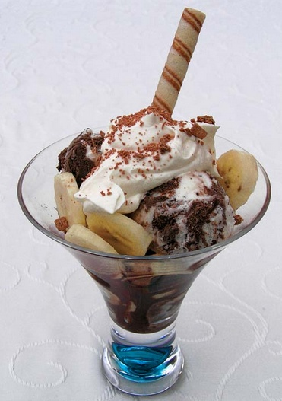
The Basic counting principle
When dealing with the occurrence of more than one event or activity, it is important to be able to quickly determine how many possible outcomes exist.
For example, if ice cream sundaes come in 5 flavours with 4 possible toppings, how many different sundaes can be made with one flavour of ice cream and one topping?

Slide 3
Rather than list the entire sample space with all possible combinations of ice cream and toppings, we may simply multiply: 5 × 4 = 20 possible sundaes. This simple multiplication process is known as the Counting Principle.
The Fundamental Counting Principle:
If there are a ways for one activity to occur, and b ways for a second activity to occur, then there are a × b ways for both to occur.

Slide 4
Examples:
Roll a die and flip a coin. How many ways are there to roll a die and flip a coin?
There are 6 ways to roll a die and 2 ways to flip a coin.
So there are 6 × 2 = 12 ways to roll a die and flip a coin.
Draw two cards from a standard deck of 52 cards without replacing the cards. How many ways are there to draw the two cards?
There are 52 ways to draw the first card.
There are 51 ways to draw the second card.
There are 52 × 51 = 2,652 ways to draw the two cards.

Slide 5
the Counting Principle also works for more than two activities!
A coin is tossed five times. How many arrangements are there of heads and tails?
There are 2 ways to flip each coin.
There are 2 × 2 × 2 × 2 × 2 = 32 arrangements of heads and tails.
A die is rolled four times. How many possible outcomes are there?
There are 6 ways to roll each die.
There are 6 × 6 × 6 × 6 = 1,296 possible outcomes.

Slide 6
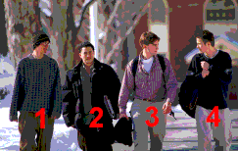
permutations
A permutation is an arrangement of objects in specific order.
The order of the arrangement is important!
Consider, four students walking toward their school entrance. How many different ways could they arrange themselves in this side-by-side pattern?
1,2,3,4 2,1,3,4 3,2,1,4 4,2,3,1
1,2,4,3 2,1,4,3 3,2,4,1 4,2,1,3
1,3,2,4 2,3,1,4 3,1,2,4 4,3,2,1
1,3,4,2 2,3,4,1 3,1,4,2 4,3,1,2
1,4,2,3 2,4,1,3 3,4,2,1 4,1,2,3
1,4,3,2 2,4,3,1 3,4,1,2 4,1,3,2
There are 24 different arrangements, or permutations, of the four students walking side-by-side.
That is 4 × 3 × 2 × 1 = 4!

Slide 7
The number of permutations of n different objects is
n! = n (n-1)(n-2)×…×3×2×1

Slide 8
examples
Question: Five different books are on a shelf. In how many different ways could you arrange them?
Answer: 5! = 1×2×3×4×5 = 120

Slide 9
Question: There are 6! permutations of the 6 letters of the word ‘square’.
a) In how many of them is r the second letter? _ r _ _ _ _
b) In how many of them are q and e next to each other?
Solution:
a) Let r be the second letter. Then there are 5 ways to fill the first spot. After that has happened, there are 4 ways to fill the third, 3 to fill the fourth, and so on. There are 5! such permutations (5! = 120).
b) Let q and e be next to each other as qe. Then we will be permuting the 5 units qe, s, u a, r.. They have 5! permutations. But q and e could be together as eq. Therefore, the total number of ways they can be next to each other is 2×5! = 240.

Slide 10
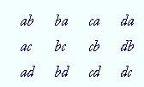
Permutations of less than all
Imagine putting the letters a, b, c, d into a hat, and then drawing two of them in succession.
We can draw the first in 4 different ways: either a or b or c or d.
After that has happened, there are 3 ways to choose the second. That is, to each of those 4 ways there correspond 3.
Therefore, there are 4×3 or 12 possible ways to choose two letters from four.

Slide 11
The number of ways of choosing 2 letters from 4 is 4×3 = 12.
We will symbolize this as ⁴P₂: ⁴P₂ = 4×3
The lower index 2 indicates the number of factors. The upper index 4 indicates the first factor.
For example, ⁸P₃ means "the number of permutations of 8 different things taken 3 at a time."
And ⁸P₃ = 8×7×6 = 336
There are 8 ways to choose the first, 7 ways to choose the second, and 6 ways to choose the third.

Slide 12

Example: what order could 16 pool balls be in?
Answer: 16! = 20,922,789,888,000
Example: How many ways could 3 pool balls could be arranged out of 16 balls?
Answer: ¹⁶P₃ = 16 × 15 × 14 = 3,360
Notice:
Do you see? 16! / 13! = 16 × 15 × 14

Slide 13
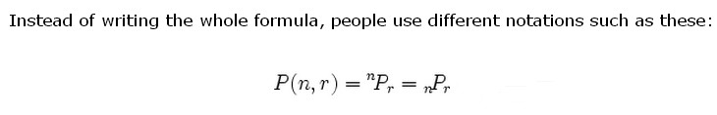

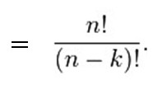
In general,

Slide 14
Combinations
"My fruit salad is a combination of apples, grapes and bananas"
We don't care what order the fruits are in, they could also be "bananas, grapes and apples" or "grapes, apples and bananas", its the same fruit salad.
So if the order does matter it is a Permutation.
If the order doesn't matter, it is a Combination.
There are also two types of combinations:
Repetition is Allowed: such as coins in your pocket (5,5,5,10,10)
No Repetition: such as lottery numbers (2,14,15,27,30,33)

Slide 15
Combinations without Repetition
Example: How many ways could 3 pool balls could be arranged out of 8 balls?
This is a permutation problem: the order matters!
The answer is ⁸P₃ = 8×7×6 = 336
But if you had three red balls, and 5 other balls, and you asked the question: “How many ways could the 3 red balls could be arranged out of 8 balls?”
This time, the order of the three red balls doesn’t matter!

Slide 16
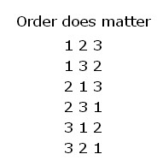
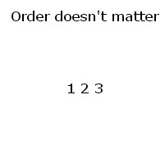
For example, let us say balls 1, 2 and 3 are chosen. These are the possibilities:
So, the permutations will have 6 times as many possibilities.
In fact there is an easy way to work out how many ways "1 2 3" could be placed in order, and we have already talked about it. The answer is:
3! = 3 × 2 × 1 = 6

Slide 17

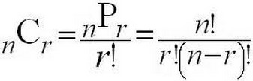

So we adjust our permutations formula to reduce it by how many ways the objects could be in order (because we aren't interested in their order any more):
This is the formula for combinations!
Just like permutations, we can write ^{n}C_{r} in lots of different ways:

Slide 18
Question: If everyone in this class shook hands with each other person once, how many handshakes would there be?

Slide 19
Combinations with repetition
Let us say there are five flavors of ice cream: banana, chocolate, lemon, strawberry and vanilla.
We can have three scoops. How many variations will there be?
Let's use letters for the flavors: {b, c, l, s, v}. Example selections include:
{c, c, c} (3 scoops of chocolate)
{b, l, v} (one each of banana, lemon and vanilla)
{b, v, v} (one of banana, two of vanilla)
And just to be clear: There are n=5 things to choose from, and we choose r=3 of them.
Order does not matter, and we can repeat!

Slide 20

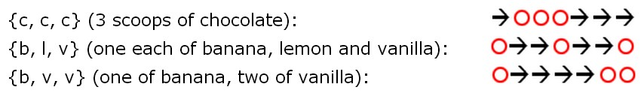
So it is like we are ordering a robot to get our ice cream.
We can write this down as
In fact the three examples above can be written like this:

Slide 21
OK, so instead of worrying about different flavors, we have a simpler question: "how many different ways can we arrange arrows and circles?"
Notice that there are always 3 circles (3 scoops of ice cream) and 4 arrows (we need to move 4 times to go from the 1st to 5th container).
So (being general here) there are r + (n−1) positions, and we want to choose r of them to have circles.
This is like saying "we have r + (n−1) pool balls and want to choose r of them". In other words it is now like the pool balls question, but with slightly changed numbers.

Slide 22


We can write it like this:
(note: r+(n−1) is the same as n+r−1)
So, what about our example, what is the answer?

Slide 23

To sum up
Permutations (repetition not allowed):
Combinations (repetition not allowed):
Combinations (repetition allowed):

